Slide 1

Unit Testing
Independently scrutinizing the smallest unit of program for proper operation

Slide 2
Outline
Intro
Setup & Validate your Unit
Mock your dependent modules using injection - MVC
Web API unit Testing - .NET Core
Unit Testing in the context of SPA - VueJs

Slide 3
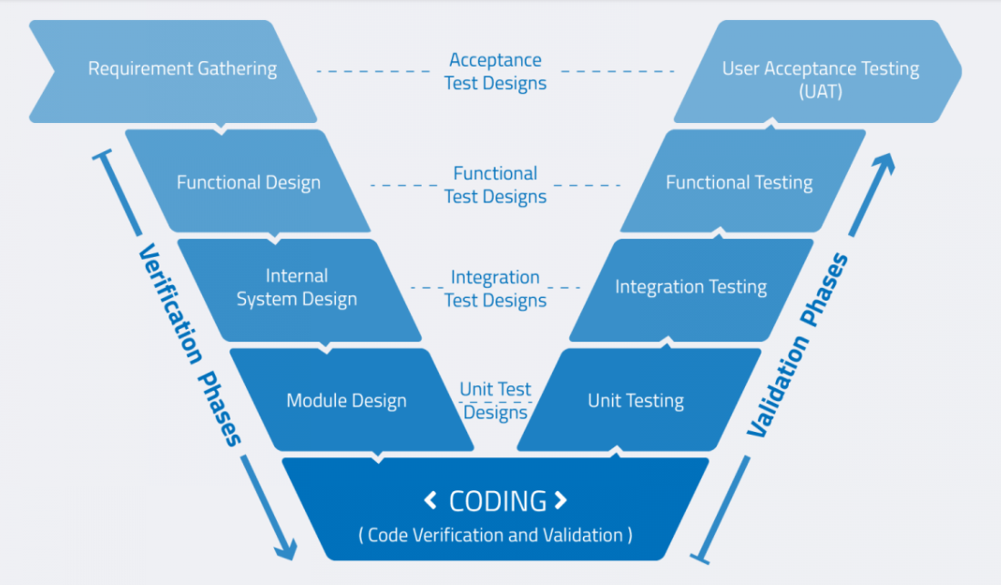
Verification & Validation
V&V
Why?
Verification : If we are building the product right way
Validation : If right product is built
How?
Verification : Involves process like- walkthrough, inspection, reviews etc.
Validation : Uses methods like black box testing, white box testing and non-functional testing etc
When?
Verification: Finds bugs in early stage of SDLC
Validation: Comes after Verification
What for?
Verification: Targets software architecture, design, database etc.
Validation: Focus on the actual software product
Who?
Verification: QA team
Validation: Mainly Testing team with QA team
Example: Payment process
Verification: Static Process to verify requirements/specification are covered
Validation: Dynamic process, requires code execution to confirm it behaves accurately

Slide 4
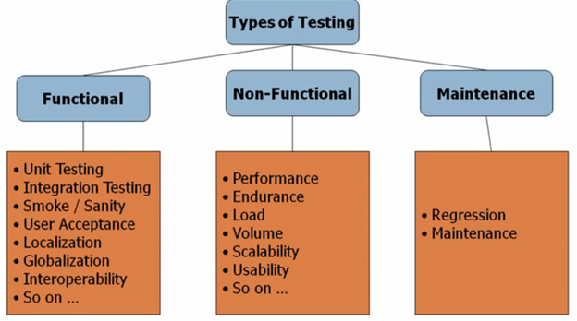
Types of Validation & Unit Testing
Way of validating smallest logically isolated piece of code in the system
Usually, IDEs are integrated with unit testing framework to support – creating , run, and report result of unit tests cases. Like MSTest framework for Visual studio
Otherwise, external testing framework can be integrated with your IDE like, Jbehave in Eclips for Java development or Nunit or Xunit for MS visual studio
Goal :
Should cover Positive and Negative Test cases
Make sure unit test is self executable and as independent as possible
Unit testings are problematic for UI testing but good for business logic
Unit tests only test sets of data and its functionality—it will not catch errors in integration.
More lines of test code may need to be written to test one line of code—creating a potential time investment.
Unit testing may have a steep learning curve, for example, having to learn how to use specific automated software tools.
Interesting Fact: xUnit is created by the same creator of nUnit which is much more extensible than MsTest or nUnit.
Intro
Setup & Validate your Unit
Service Dependency
Database Dependency
UI & API Service
Notes:
Sustainability
For nUnit : Download nUnit Test Adapter using ‘Tools > Extensions and Update’ From Visual Studio and menu and integrate with Visual Studio Test runner for result report

Slide 5
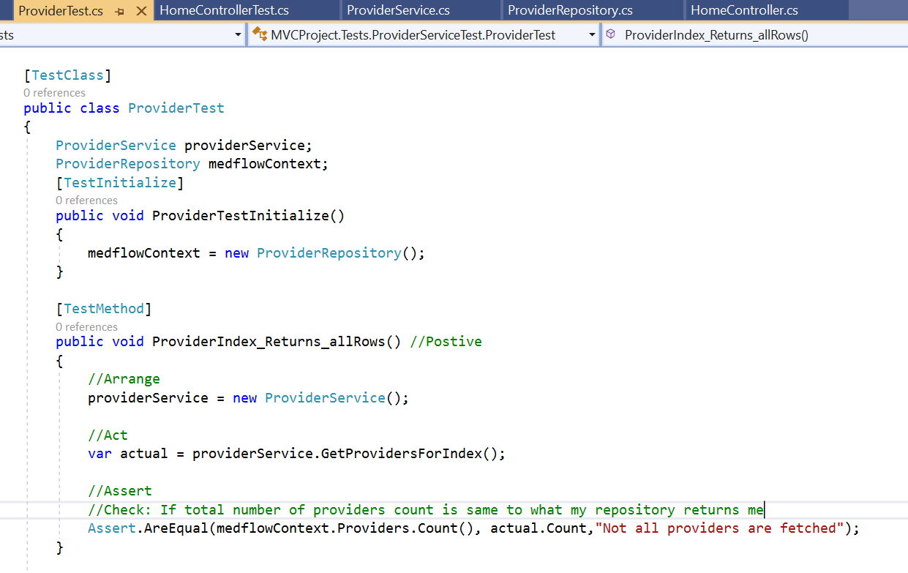
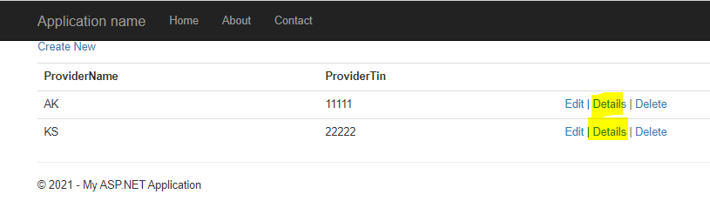
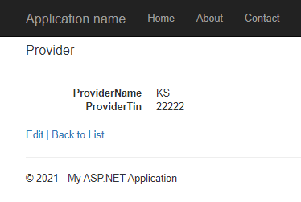
Unit Testing – In Action
Scenario-1 :
Use Case: I am getting some data from my data repository, and I would like to test if all data is returned from repository or not
Use Case: I want to also test that provider search is service is returning correct data or not.
Downside: The Unit testing so tied up with data repository that if repository is down or changed, unit test may impact.
Setup & Validate your Unit
Intro
Service Dependency
Database Dependency
UI
Notes:
http://localhost:64786/Provider/Index
http://localhost:64786/Provider/Details/100

Slide 6
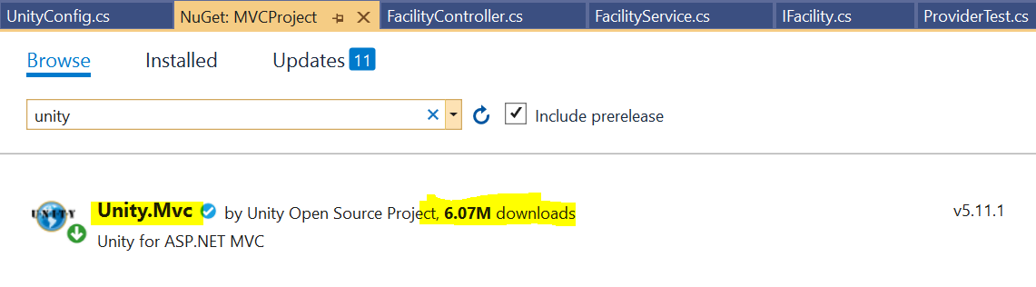
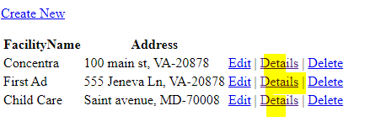
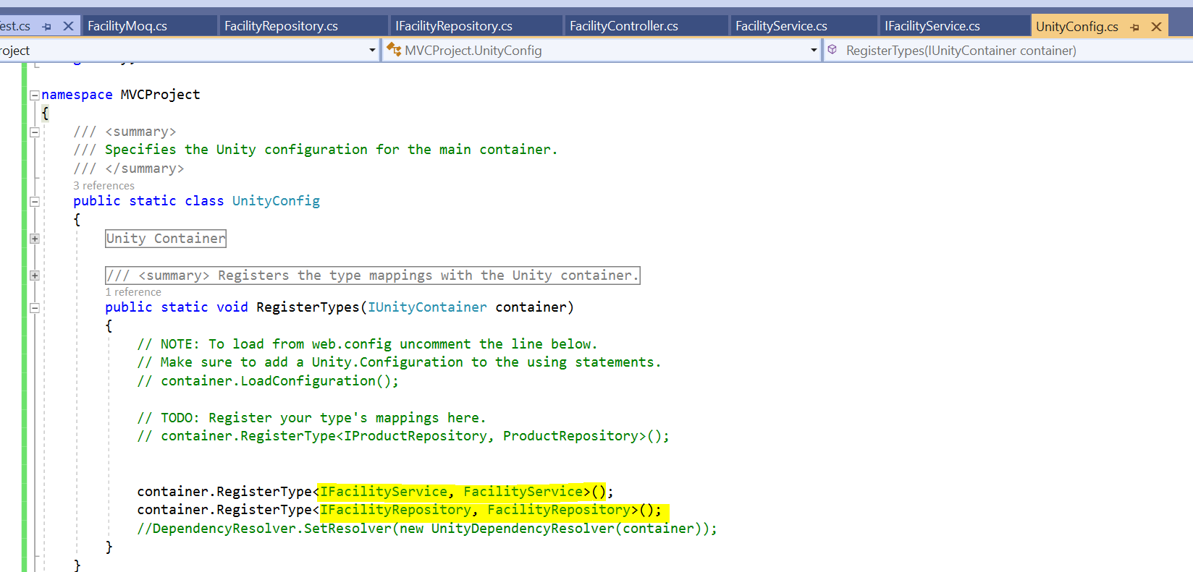
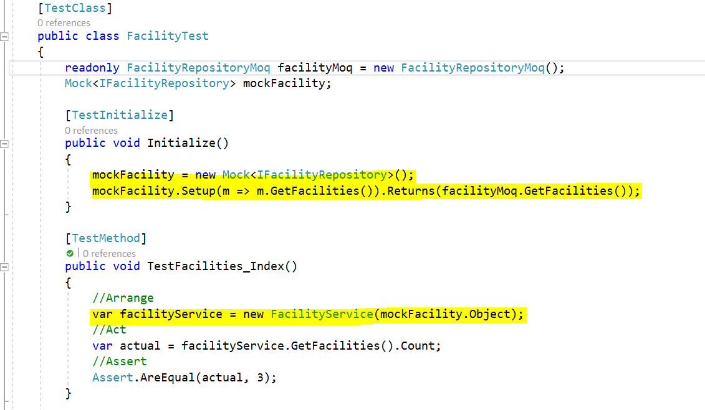
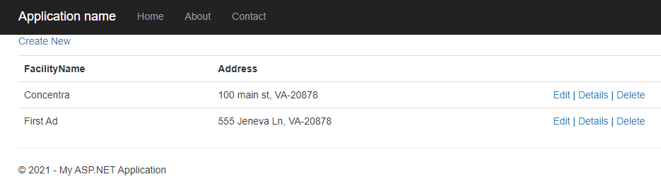
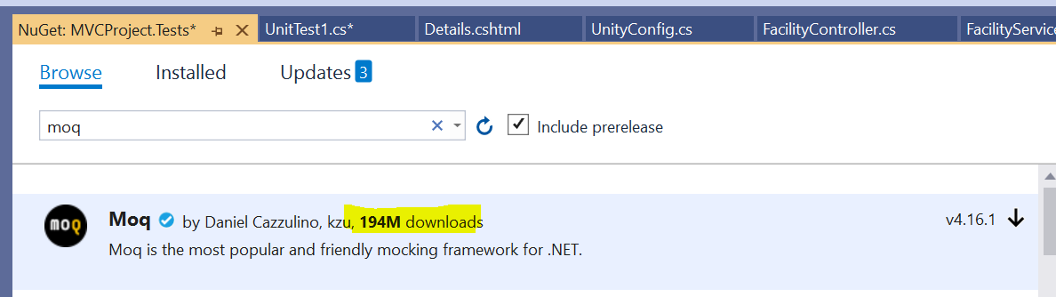
Unit Testing – Mocking your repository using DI
Scenario-2:
Use Case: My Service is based on some data repository to get data and perform search operation. I would like to test my service module regardless of data repository.
I should be able to test my functionality regardless of Repository.
Note: Unity.Mvc Nuget Package => to inject Repository/Service at run time into MVC project. This way controller can be tested alone by injecting any moq service to it from unit testing module.
Moq Nuget Package => To mock the Repository into Test Project (in this example).
Setup & Validate your Unit
Intro
Service Dependency
Database Dependency
UI
Notes:
http://localhost:64786/Facility/Index
http://localhost:64786/Facility/FacilityByZip?value=20878

Slide 7
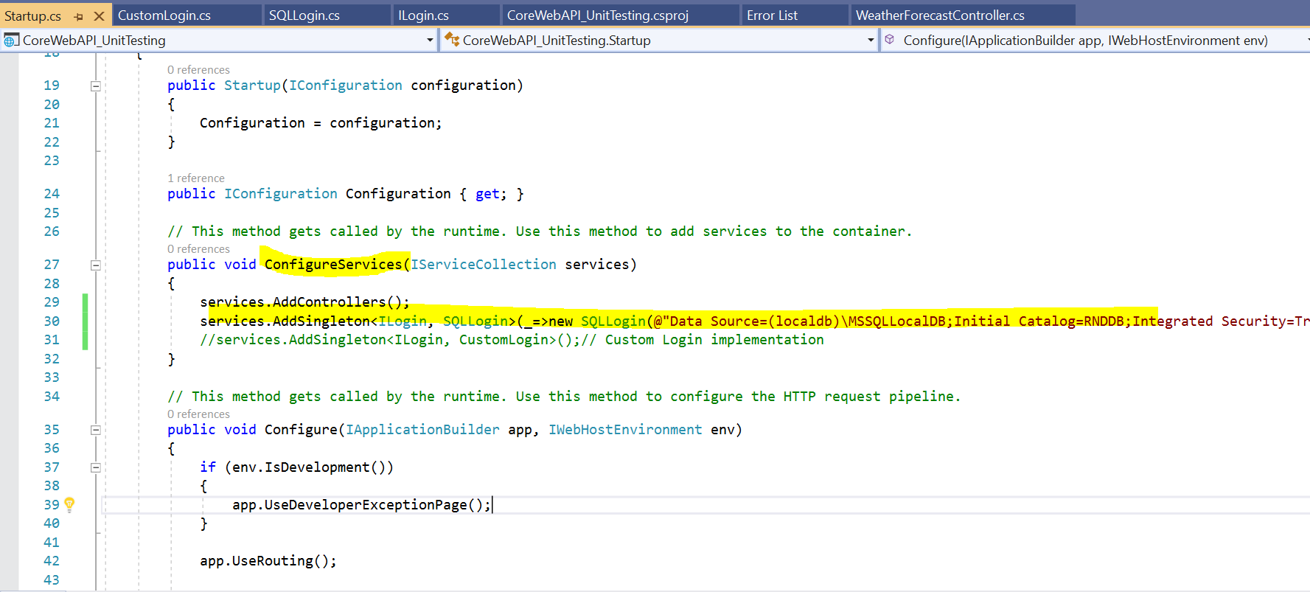
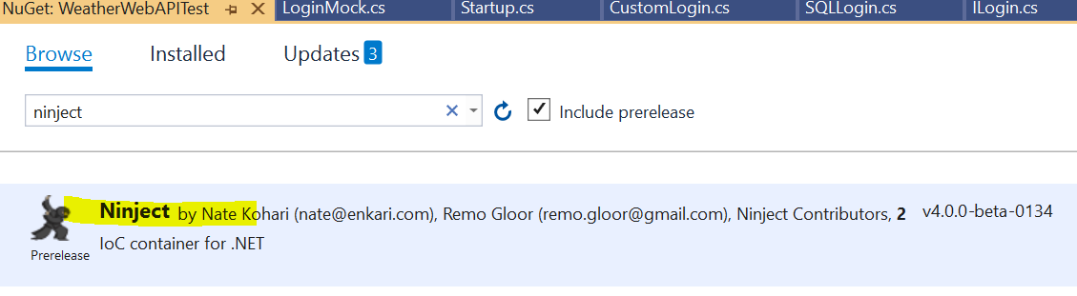
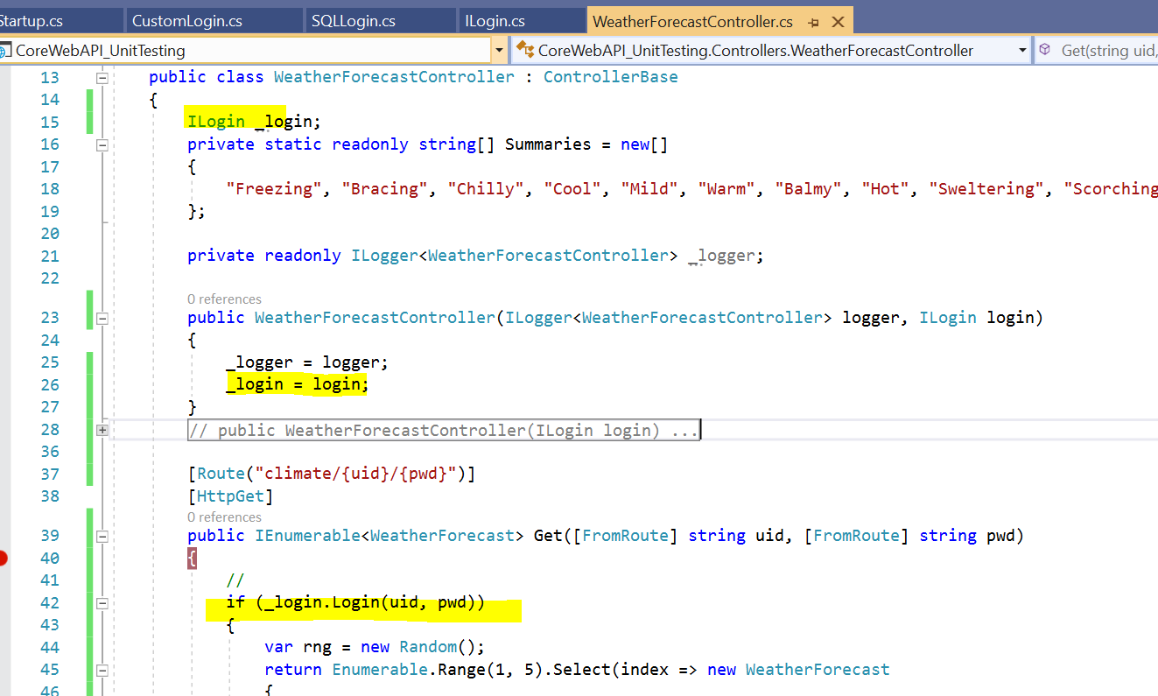
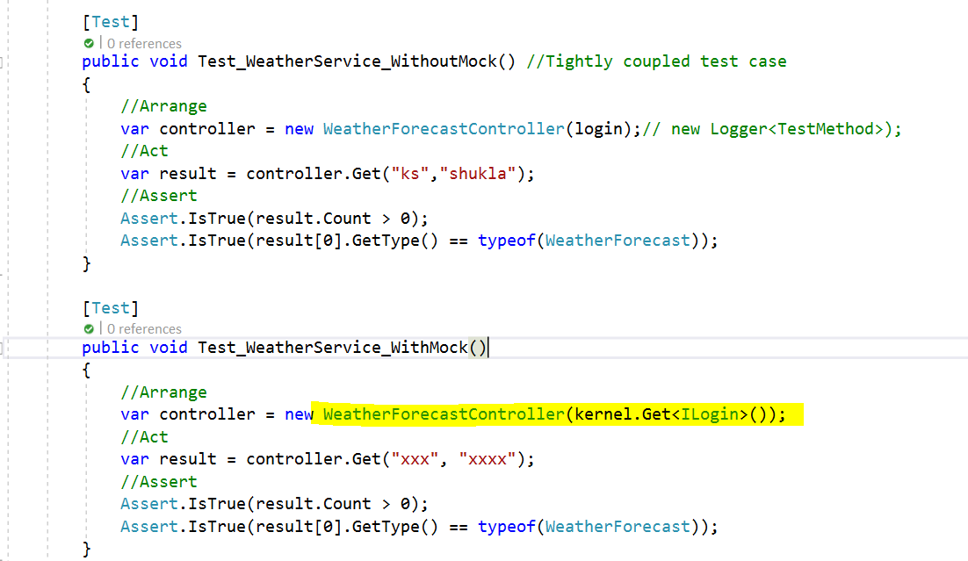
Unit Testing –DI in core Web API & Ninject for unit Testing
Scenario: Web API needs to serve data after successful user validation based on given user id and password
Use Case:
Test My controller and Action method logic if it returns right data or not. My Test case should not be dependent on Login mechanism.
Implemenatation:
Unit testing by Mocking Login service
Database Dependency
Intro
Setup & Validate your Unit
Service Dependency
UI
Notes:
http://localhost:52499/swagger/index.html
http://localhost:52499/weatherforecast/climate/ak/kumar

Slide 8
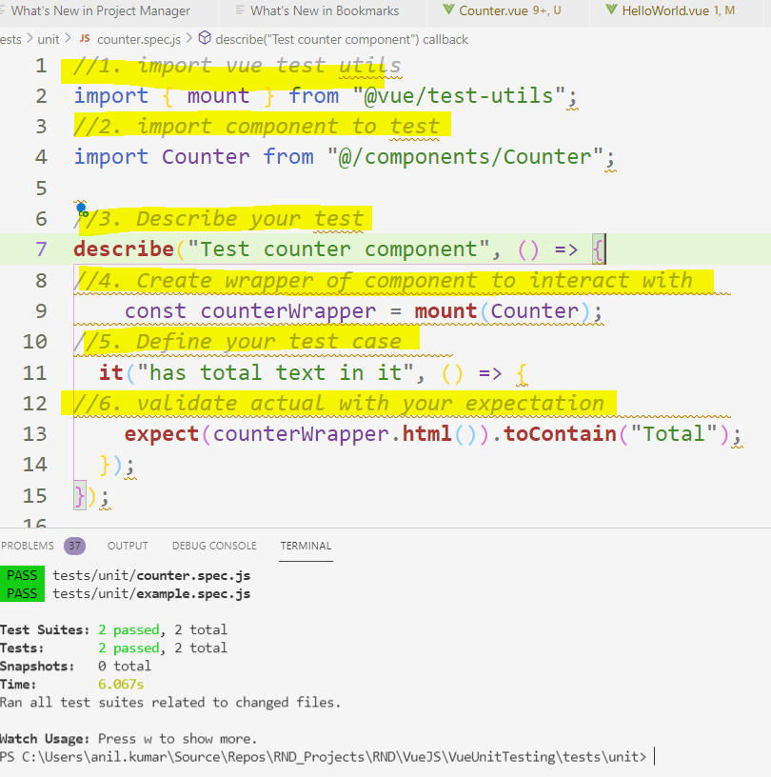
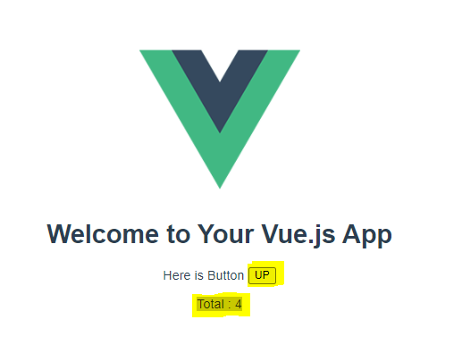
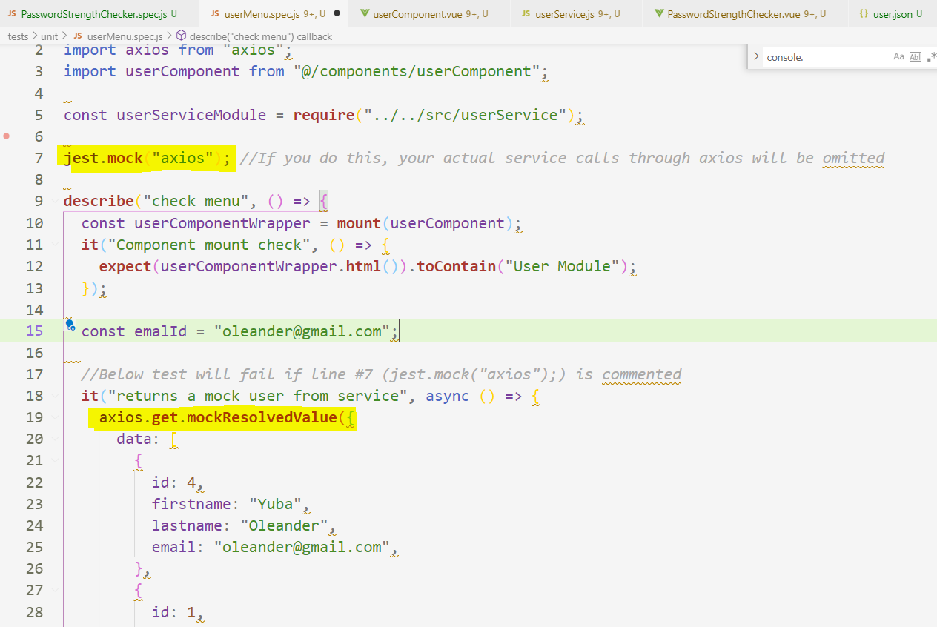
Unit Testing : Vue Application
Intro
There are three categories in the context of web applications testing:
Unit Testing : Jest, Mocha or KARMA with Chai etc
Component Testing : Vue Testing Library (@testing-library/vue) OR Vue Test Utils
End-To-End (E2E) Testing : Cypress (only for chrome) , Nightwatch
Note:
For component testing, you need to mount your component to the DOM in order to fully assert that they are working
Mocha is JavaScript based test Framework for Node Js and browser.
Chai is assertion library for node and browser. Together they can be categorized as “JavaScript Testing Framework” Tools.
Interesting Fact: Jest is developed by Facebook
Intro
Setup & Validate your Unit
Service Dependency
Database Dependency
UI Testing
Notes:
npm run test:unit //Run through command
expect(response.status).toBe(200); //Assert your service response :
Funny ☺ : ‘Your test suite must contain at least one test’ – had forgot to save file after first test case.

Slide 9
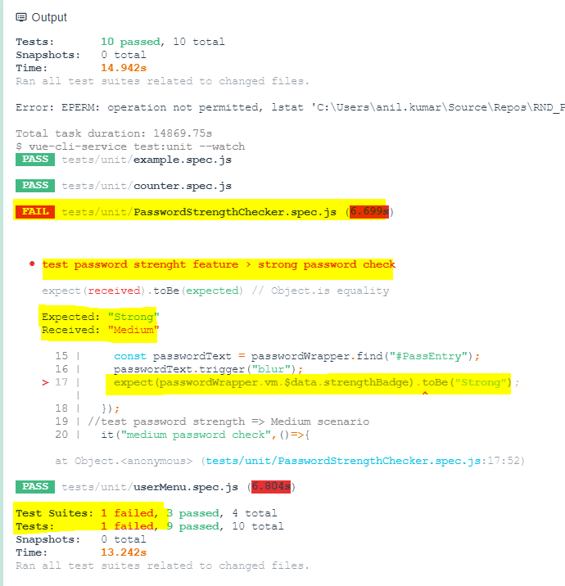
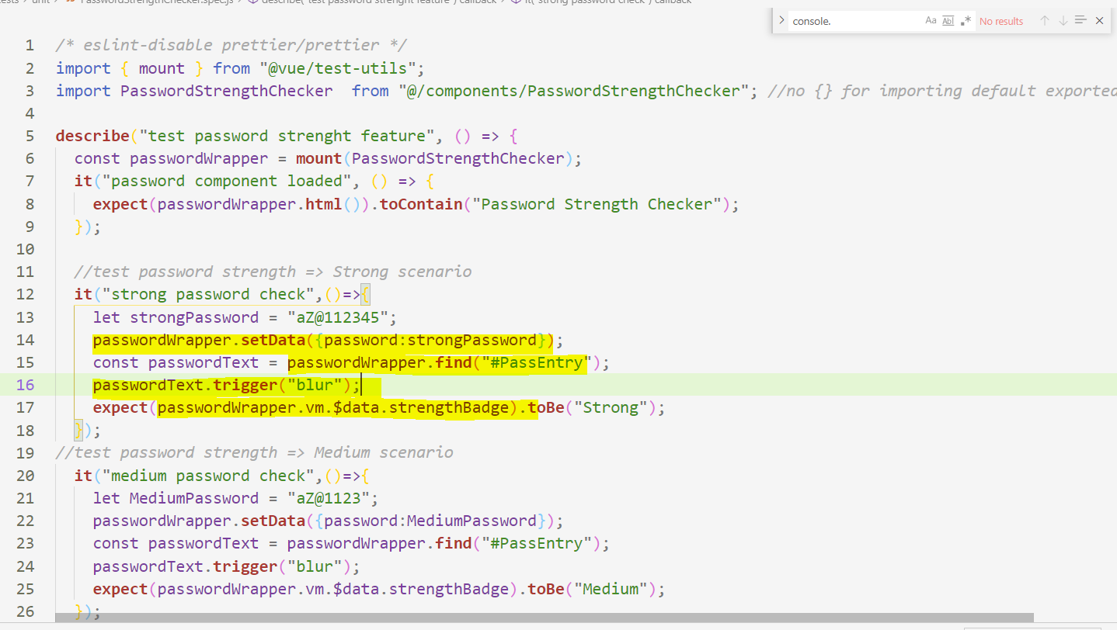
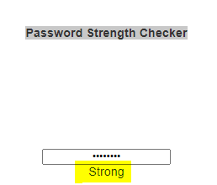
Unit Testing : Vue Application – Testing your business logic
Scenario:
Test Case: I have a business logic to accept data and process it. Based on result take the decision
Intro
Setup & Validate your Unit
Service Dependency
Database Dependency
UI Testing
Notes:
npm run test:unit //Run through command
expect(response.status).toBe(200); //Assert your service response :
Funny ☺ : ‘Your test suite must contain at least one test’ – had forgot to save file after first test case.

Slide 10
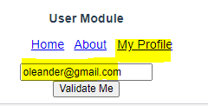
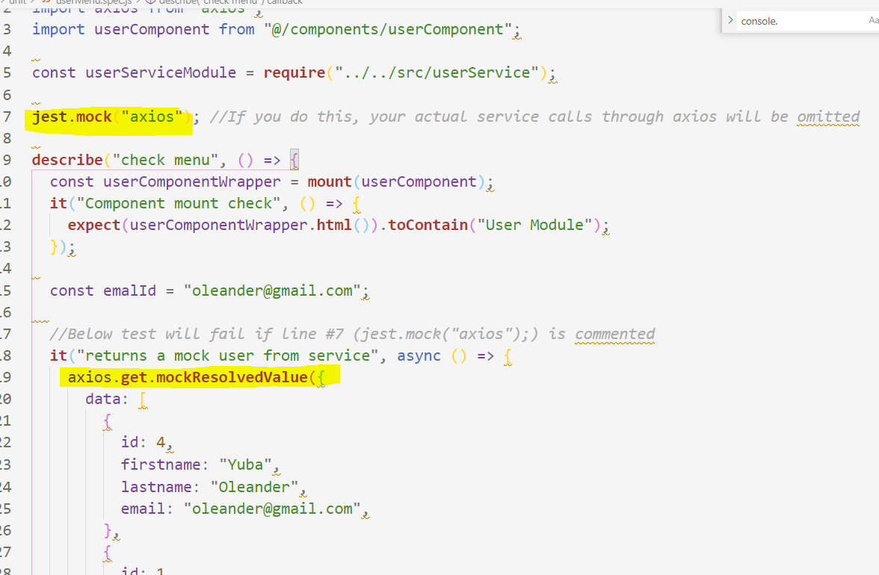
Unit Testing : Vue Application - Mocking service call
"
Scenario: My component is based on external service
Test Case: I want to test my component by mocking the service inside
Setup Service
Install express for Node based web API
Install Axios for api access
Jest Mock
jest.mock(<module-name>), gives complete control over all functions from that module
Example, jest.mock('axios'), Jest replaces every function in the axios module with empty "mock" functions
Note:
Make sur ethe port is different than vue app (8080) otherwise you will not be able to run both same the time. And 8081 thrown permission error so used 8088
var server = app.listen(8088, "127.0.0.1", function () {
Node is runtime environment to create all kinds of server-side tools and applications in JavaScript. Express is the most popular Node web framework and is the underlying library for several other popular Node web frameworks.
UI Testing
Intro
Setup & Validate your Unit
Service Dependency
Database Dependency
Notes:
npm run test:unit //Run through command
expect(response.status).toBe(200); //Assert your service response :
Funny ☺ : ‘Your test suite must contain at least one test’ – had forgot to save file after first test case.
127.0.0.1:8088/getUsers
127.0.0.1:8088/getUsers/saffron@gmail.com
http://localhost:3000/ : express service
Add watch on test cases :
Update package.json (test:unit:watch": "vue-cli-service test:unit --watch", )
Run test in watch mode (npm run test:unit:watch )

Slide 11

Conclusion
It will a best practice to introduce unit test first for your feature and then write actual code for it. This way you have eaten the frog first before your desert
“If you are integrating unit testing into your legacy code” , There are three candidates for code that should get unit tests.
First, code you are modifying.
Second, code that has lots of bugs or customers complain about most.
Third, areas of code that you are afraid to modify because it’s fragile and breaks every time you change it.
Conclusion
Intro
Setup & Validate your Unit
Service Dependency
Database Dependency
UI Testing

Slide 12
References
May be helpful:
http://www.ncrunch.net
Guides | Vue Test Utils (vuejs.org)
Express/Node introduction - Learn web development | MDN (mozilla.org)
jest-mock-axios - npm (npmjs.com)
Conclusion
First Skill
Second Skill
Third Skill

Slide 13
TODO
Auto test execution with code change
Auto execution integration with CI/CD

